Slide 1
Telecom Customer Churn Prediction
April 25, 2024
Surya Kiran Varma Vegesna

Slide 2
Problem Statement
A telecommunications company is experiencing high customer churn rates, leading to revenue loss and decreased customer satisfaction. Identifying the factors that contribute to customer churn and building an accurate predictive model to forecast churn risk can help the company proactively retain valuable customers and reduce churn.
Proposed Solution
To address the issue of high customer churn, we propose building a predictive model using machine learning techniques. The goal is to predict whether a customer is likely to churn based on various features such as contract type, tenure, monthly charges, internet service type, and customer demographics.

Slide 3
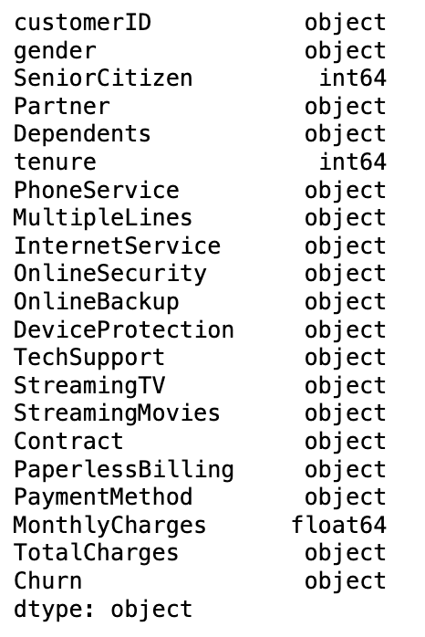
Data Description
Churn -Customers who left within the last month
Online Services that each customer has signed up for – phone, multiple lines, internet, online security, online backup, device protection, tech support, and streaming TV and movies
Customer account information - how long they’ve been a customer, contract, payment method, paperless billing, monthly charges, and total charges
Demographic info about customers – gender, age range, Partner and Dependents.

Slide 4
Data Cleaning & Preprocessing

Slide 5
Data Cleaning
Identified that the 'TotalCharges' column is in object datatype. Converted 'TotalCharges' to numeric type for statistical analysis.
We have 11 missing values in the 'Total Charges' column.
Addressed missing values by setting 'TotalCharges' equal to 'MonthlyCharges' for new customers with tenure 0.
Feature Scaling : standardized categorical variables to simplify the categories and potentially improve model performance by reducing sparsity in the dataset.
Reviewed and standardized categorical values in the 'MultipleLines' and columns related to 'Online Services' by merging by merging 'No phone service' and 'No Internet Service' with 'No'.
Data Preprocessing

Slide 6
Exploratory Data Analysis

Slide 7
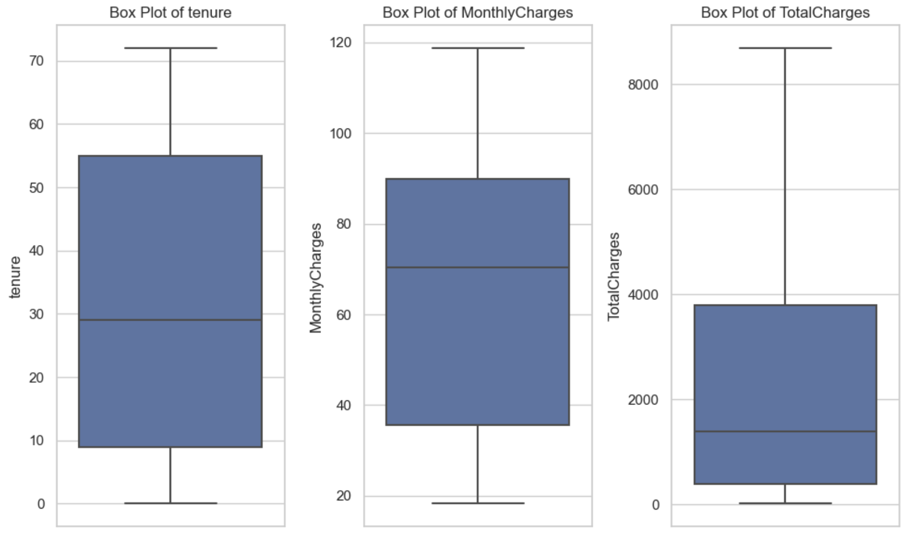
Numerical Features
box plots show no outliers for tenure and MonthlyCharges, but there are potential outliers in the TotalCharges column.
customers with very high TotalCharges could be long-standing customers with high lifetime value

Slide 8
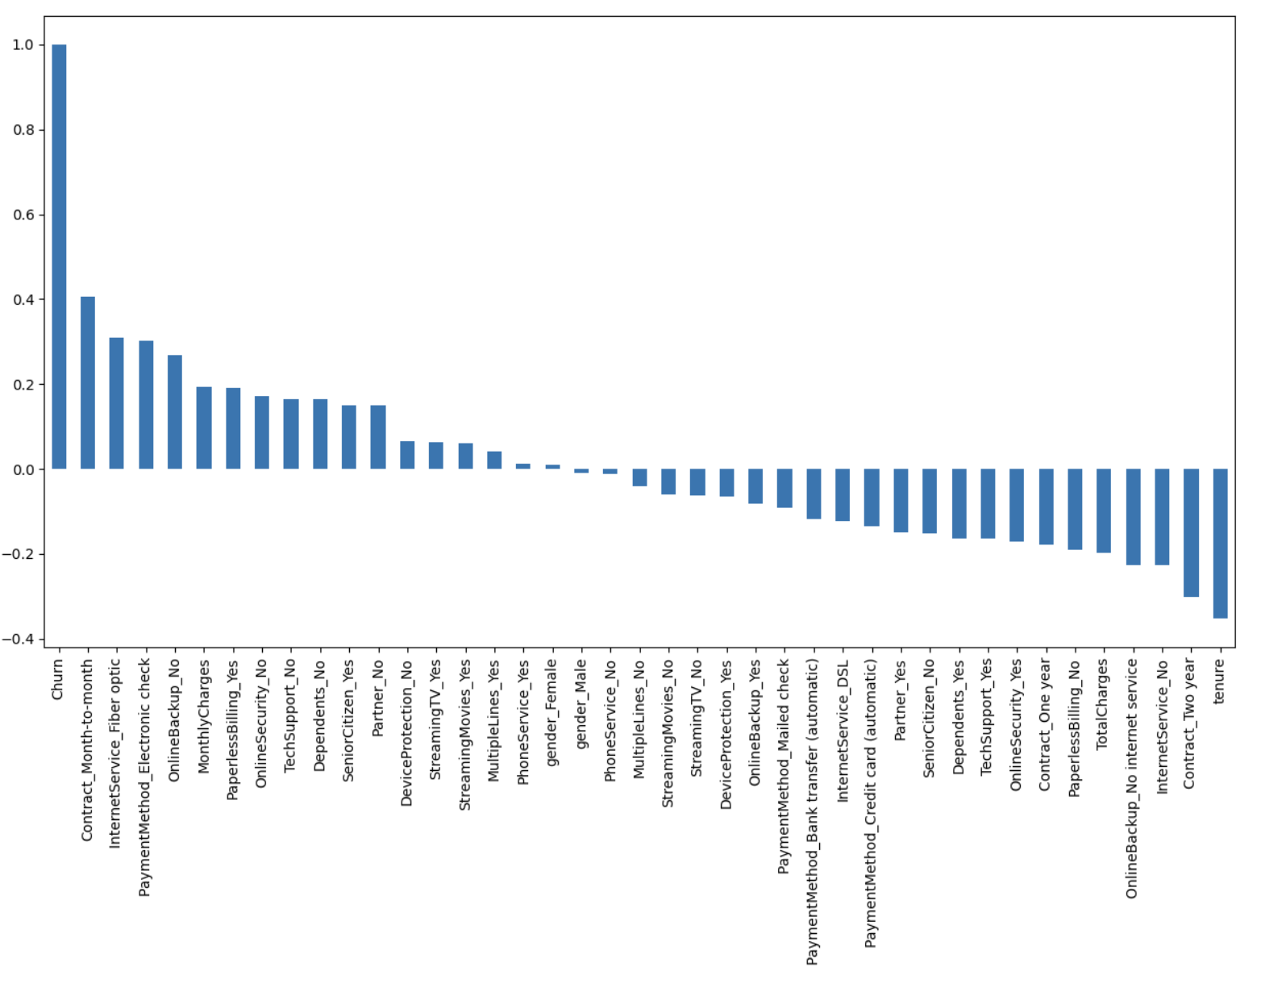
Correlation of "Churn" with other variables

Slide 9
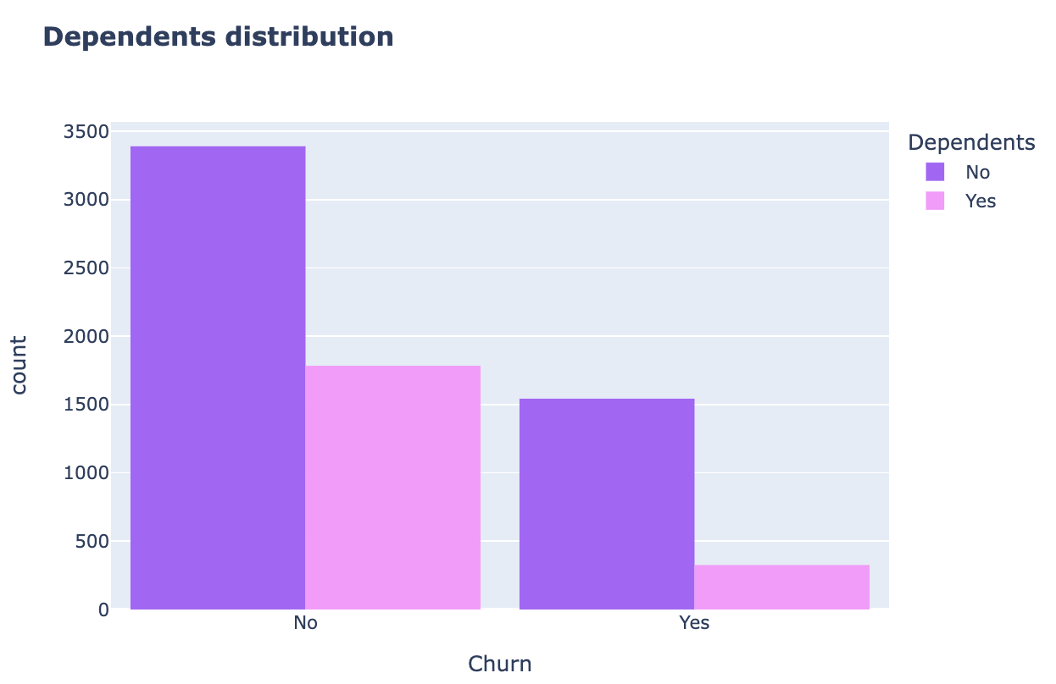
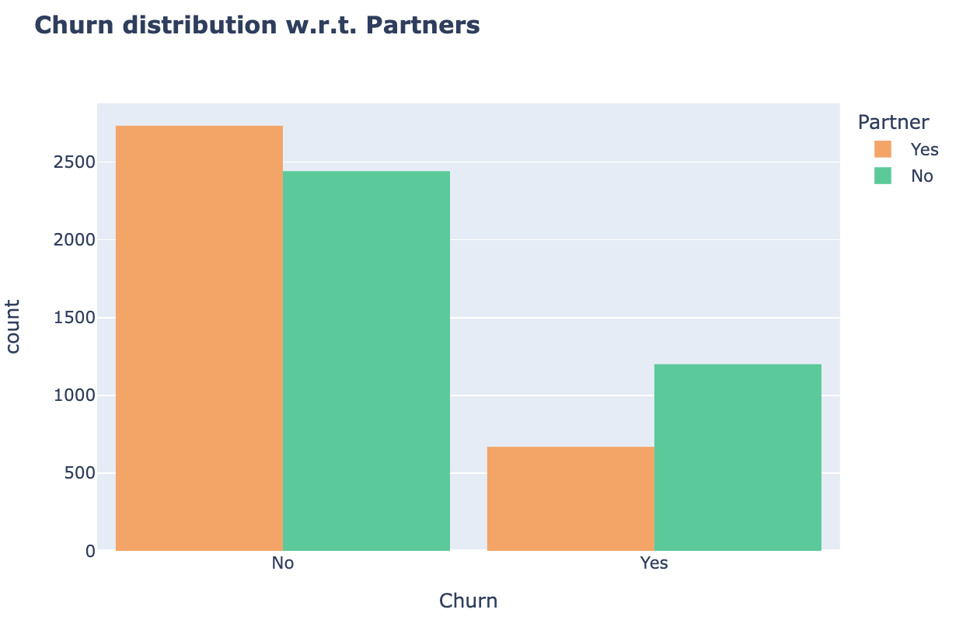
Churn Ratio w.r.t partners&Dependents
Customers without dependents and partners are more likely to churn

Slide 10
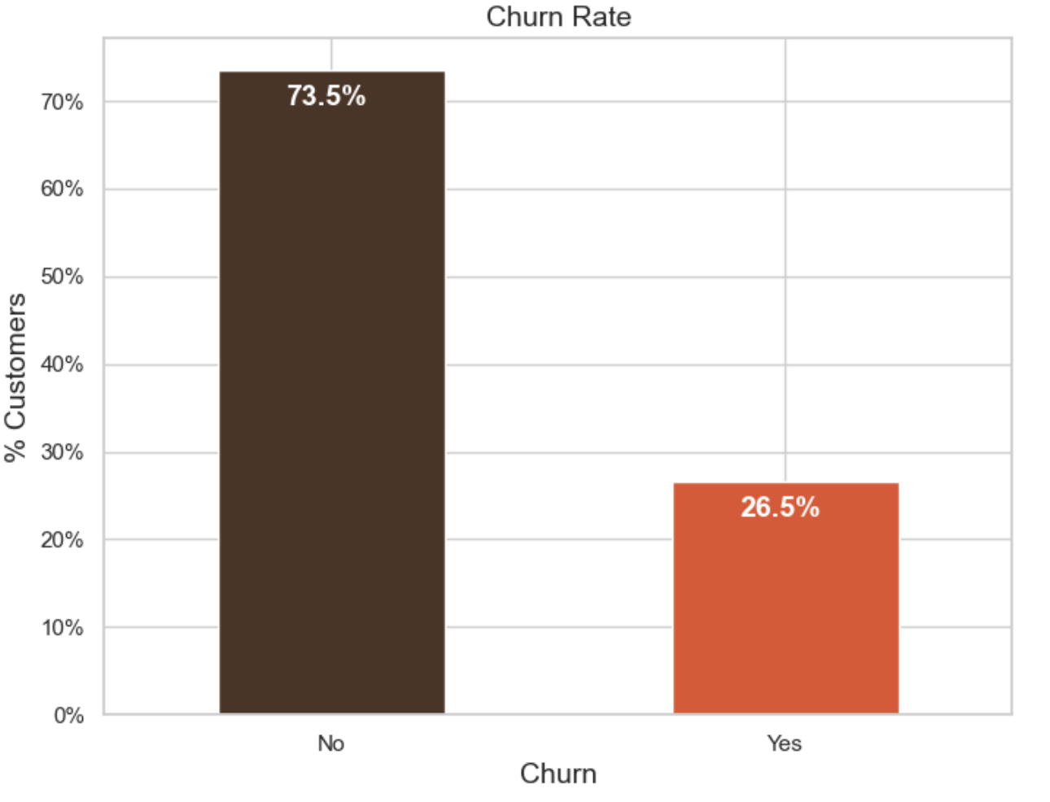
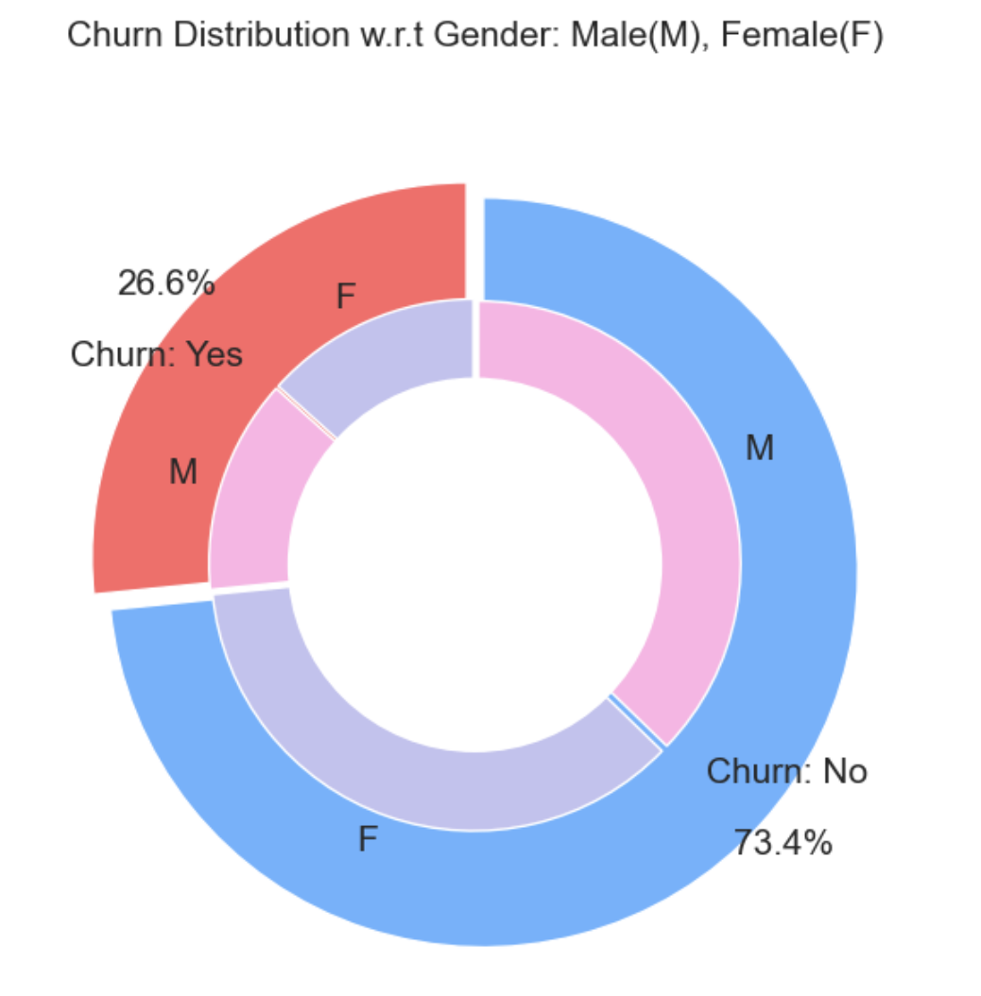
Churn Rate & Distribution w.r.t Gender
74% of the customers do not churn and 26.6% of the customers churn.
Both genders behaved in similar fashion when it comes to migrating to another service provider/firm.

Slide 11
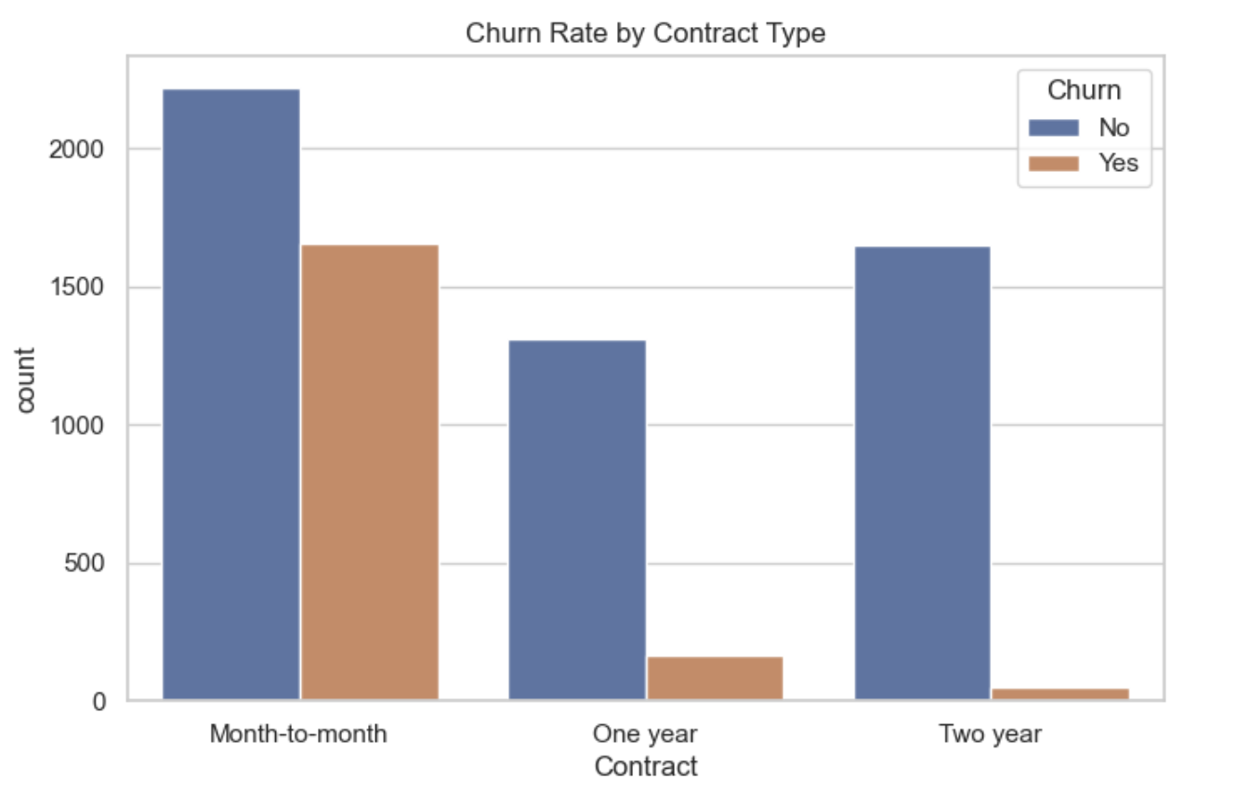
Churn Rate by Contract Type.
customers who have month-month contracts are most likely to churn, while the 2-year contracts tend to last for about 70 months.
This shows that the customers taking a longer contract are more loyal to the company and tend to stay with it for a longer period of time.

Slide 12
Feature Engineering
Engineered a new feature called "HighTenureHighMonthly". The feature is set to 1 if both 'tenure' and 'MonthlyCharges' are above their respective medians for each observation, otherwise, it's set to 0.
Customers who have been with the company for a long time and pay more than the average monthly fee might be more loyal or have a higher satisfaction level, potentially making them less likely to churn. Conversely, they could also be more at risk if they find a better offer elsewhere, considering they might save more money.
The model can then pick up on patterns that are specifically related to this segment of customers.

Slide 13
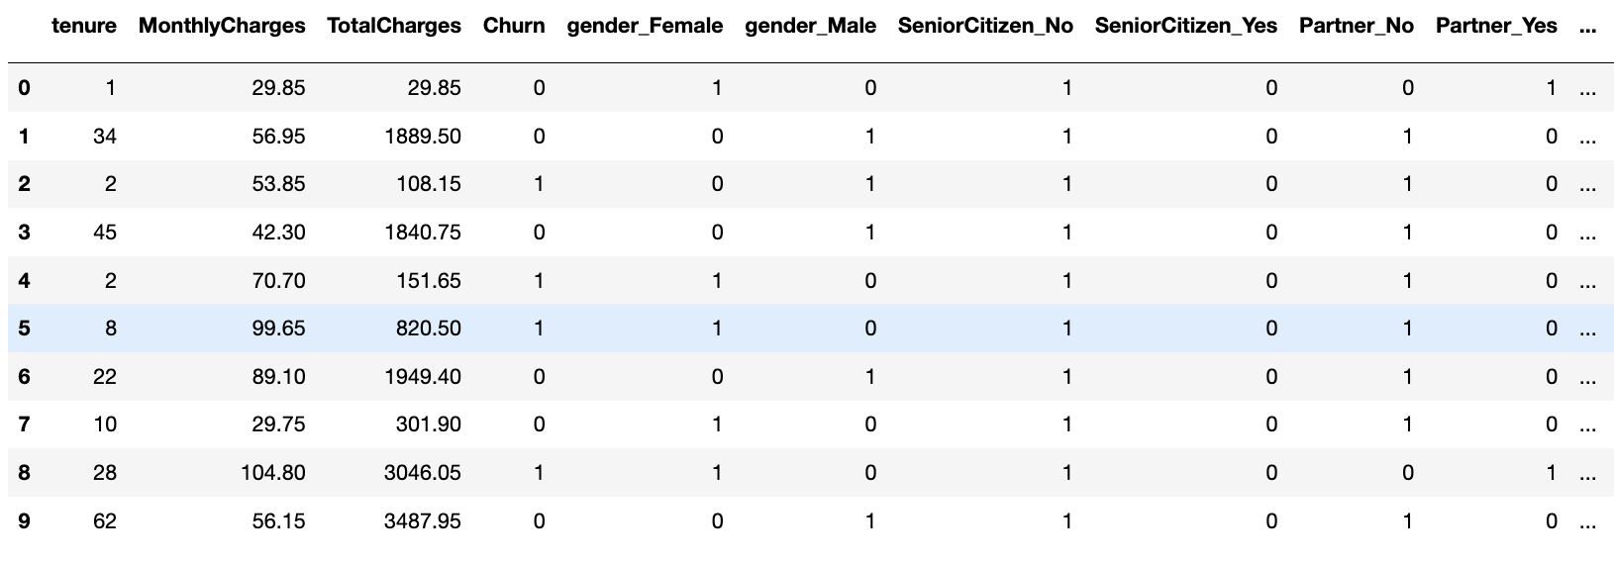
One hot encoding
Convert "Churn" to Binary Numeric: Converting it to binary numeric values (0 for "No" and 1 for "Yes") allows for easier interpretation and compatibility.
Converted all categorical variables such as such as service types and demographic information in the dataset into dummy variables. Each categorical variable is now transformed into multiple binary variables (0 or 1) representing the different categories or levels of that variable.
Scaling Variables:Utilized MinMaxScaler to scale features to a range of 0 to 1.

Slide 14
Model Development

Slide 15
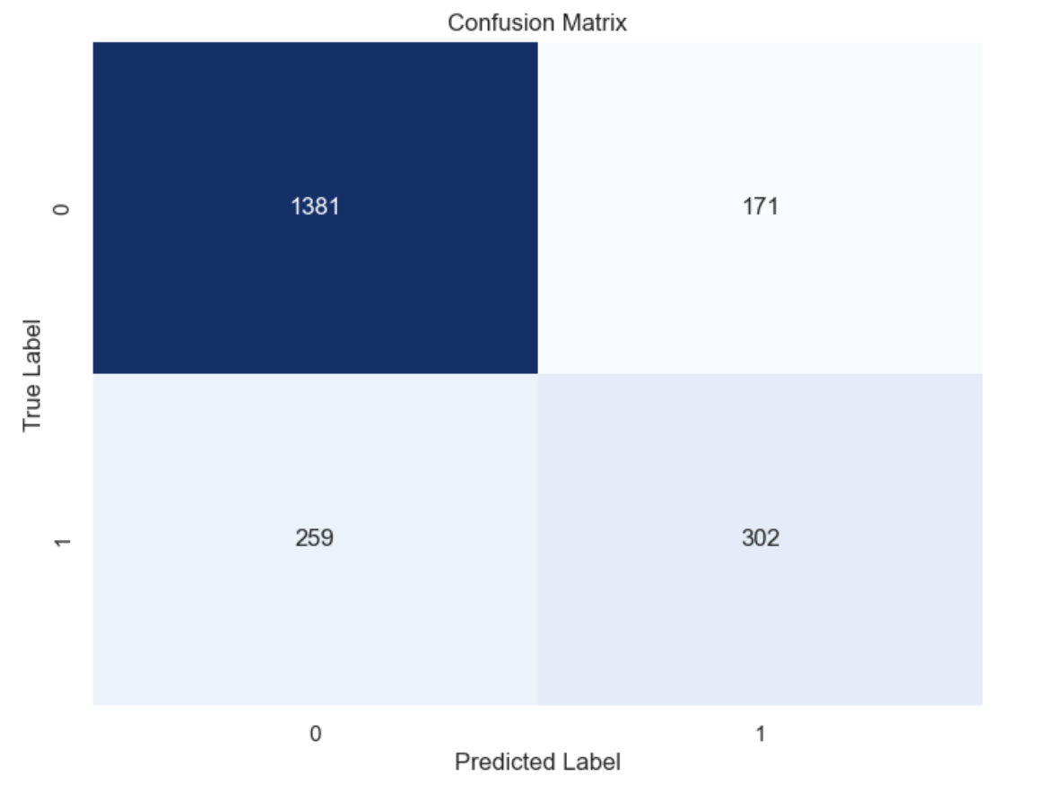
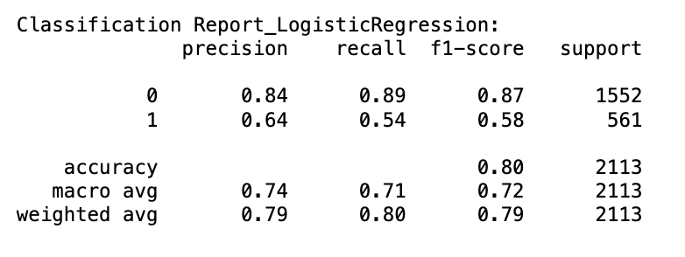
Logistic Regression
Split data into training (70%) and testing (30%) sets.
model achieved an accuracy of 80%

Slide 16
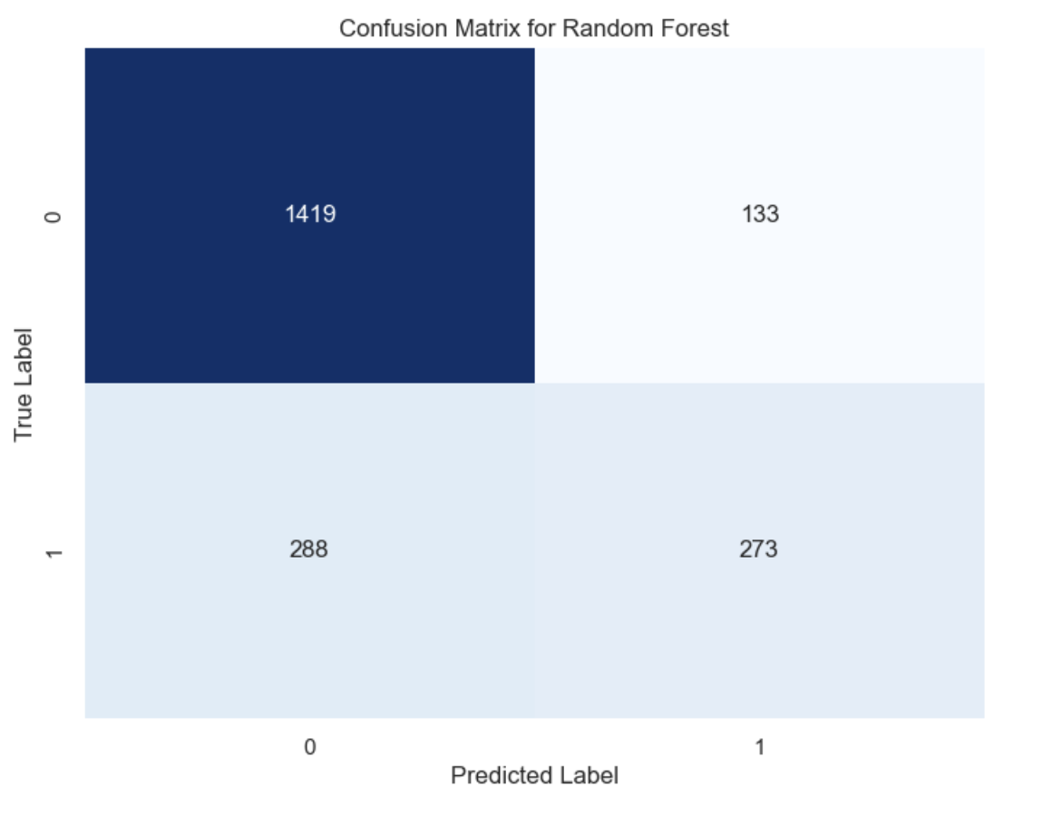
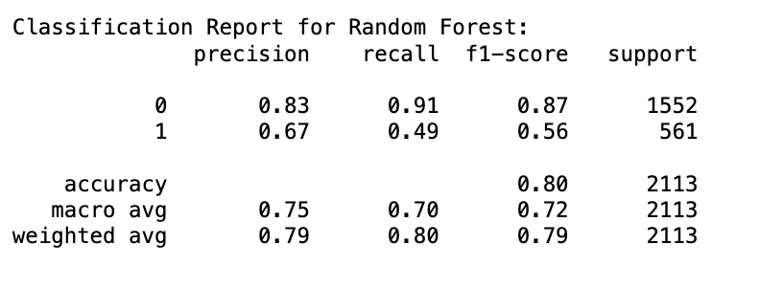
Random Forest
Accuracy Score: 0.8007572172266919

Slide 17
Results Analysis and Interpretation

Slide 18
Model Evaluation
The cross-validation scores for Logistic Regression are fairly consistent across the folds, ranging from 0.789 to 0.813, with a mean accuracy of approximately 0.803.
On the other hand, the Random Forest model has an out-of-bag (OOB) score of approximately 0.802, which is quite similar to the Logistic Regression mean accuracy obtained from cross-validation.
Based on the provided metrics, the Logistic Regression model seems to perform the best for customer churn prediction. While the Random Forest model has comparable accuracy to the Logistic Regression model, its lower recall suggests that it may miss more instances of actual churn compared to the Logistic Regression model.

Slide 19
Result & Interpretation
Logistic Regression:
Having a 2 month contract reduces chances of churn. 2 month contract along with tenure have the most negative relation with Churn as predicted by logistic regressions
Having DSL internet service also reduces the proability of Churn
Lastly, total charges, monthly contracts, fibre optic internet services and seniority can lead to higher churn rates.
Random Forest:
Monthly contract, tenure and total charges are the most important predictor variables to predict churn.
The results from random forest are very similar to that of the logistic regression and in line to what we had expected from our EDA.

Slide 20
Questions?

